Slide 1
Control Practice of Permanent Magnet DC Motor Using Arduino as Low Cost Hardware
Guided By:
Mr.T.Srikanth,M.Tech
Batch No:-4
Sairam.A (13JN1A0201)
Anil kumar.MS (13JN1A0204)
Sandhya Rani.G (13JN1A0216)
Sharanya.G (13JN1A0215)

Slide 2
Abstract
Low cost Hardware.
Open Source Platform.
Easily Programmable
Efficient PID algorithms can be Implemented
Implementation of PI controller for Sped Control of PMDC Motor.

Slide 3
Table of Contents
Introduction
Different Control Practices
Proposed System
Principle Of Operation
Implementation with Micro Controller
Components required
Open loop Control System
Closed Loop Control System
Results and Discussion
Future Scope
Conclusion

Slide 4
Introduction
Control Practises
Open Loop Control
Closed Loop Control

Slide 5
Arduino
Low Cost Hardware
Open Source
Different Varieties of Micro Controller
Easily Programmable

Slide 6
Existing System
Analogue circuit based controllers. Eg:555 timers , Counters, F to V converters
Digital Circuits using Micro-Controllers. Eg: PIC,MSP430,8051..etc
Based on Embedded C coding, Micro Python.etc

Slide 7
Proposed System
Arduino based DC motor speed controller
Programmed by using Simulink in Matlab
Live time control of DC motor from Simulink

Slide 8
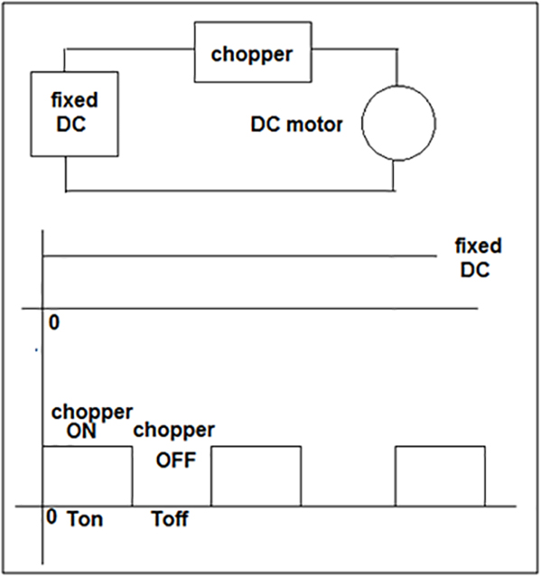
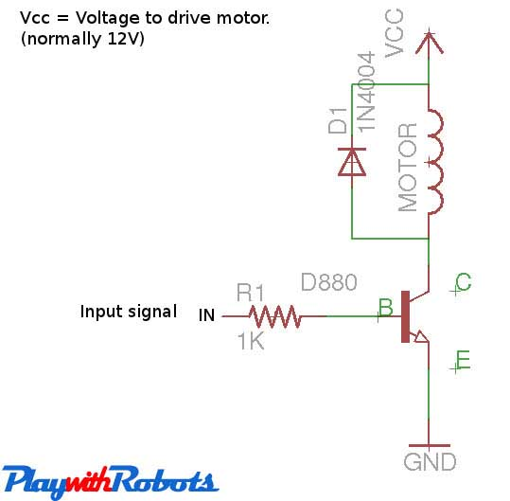
Principle of Operation

Slide 9
Components required
PC with Matlab Simulink (min 2014a)with Simulink support package for Arduino Hardware.
Arduino Hardware. (Arduino MEGA2560)
DC Motor with Hall effect quadrature encoder
Transistor(TIP41C) and Diode 1N4001

Slide 10
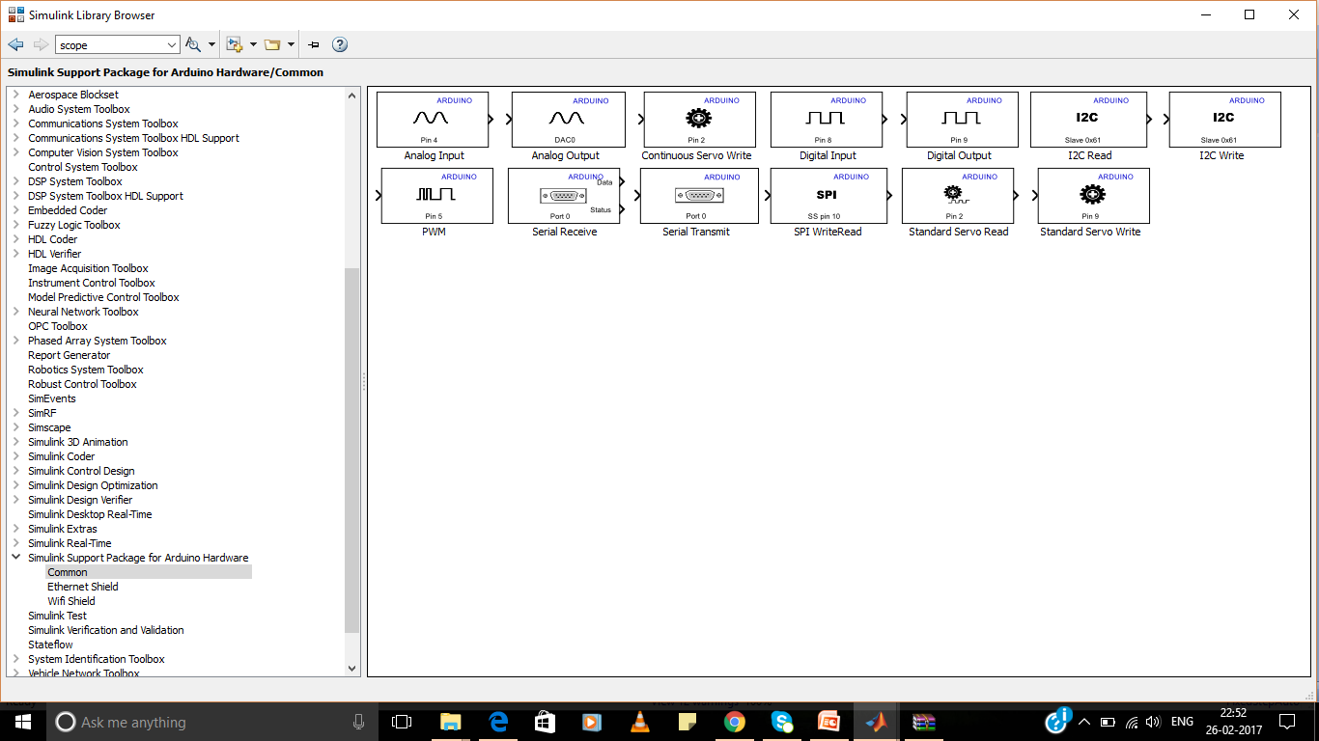
Simulink Support packages for Arduino Hardware

Slide 11
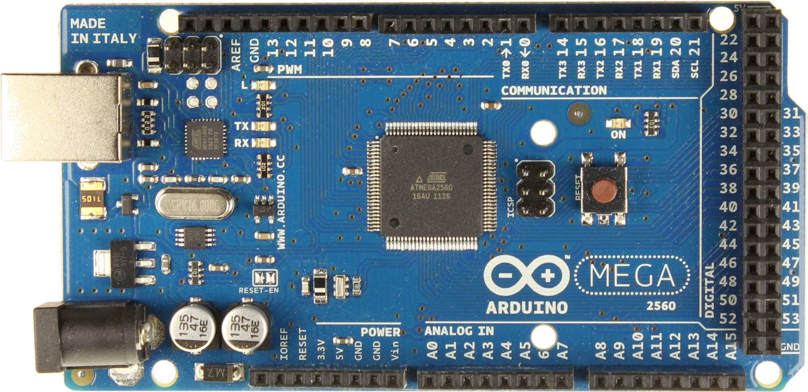

Slide 12
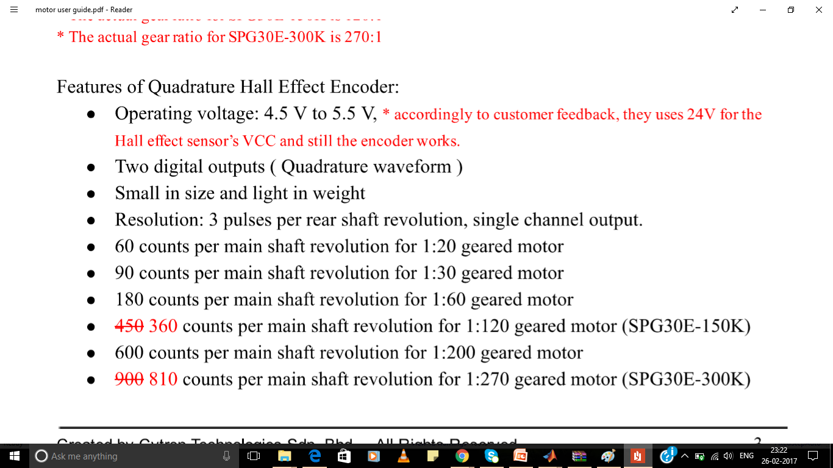
Quadrature Encoder

Slide 13
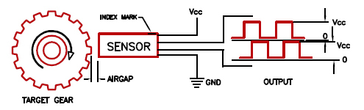
Hall Effect sensor

Slide 14
Calculation of Speed using Hall Effect Sensor Output
60
Speed =
RPM
T*N
T= Time period square wave (Sec)
N=No. Of Counts per revolution

Slide 15
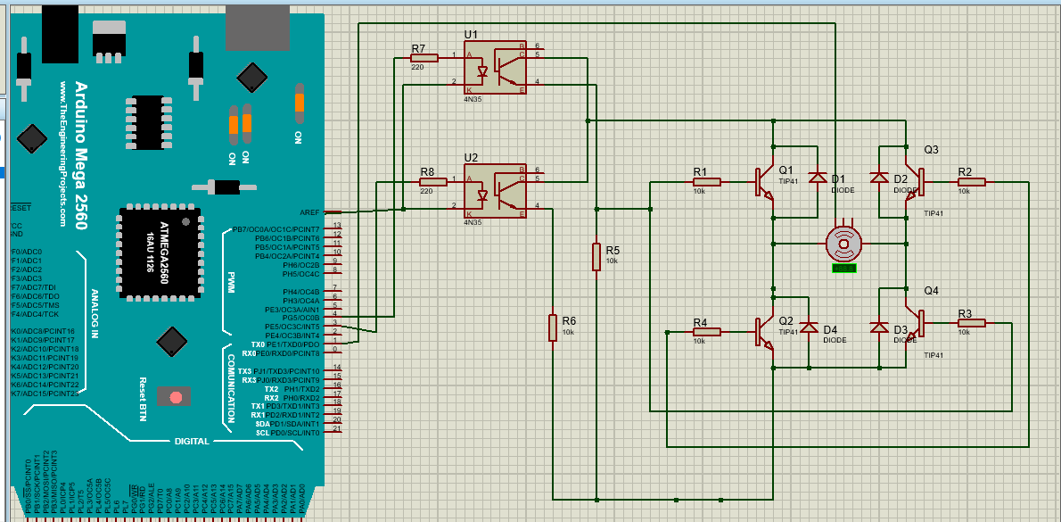
H-Bridge converter Circuit Diagram
+12v
Encoder o/p
GND

Slide 16
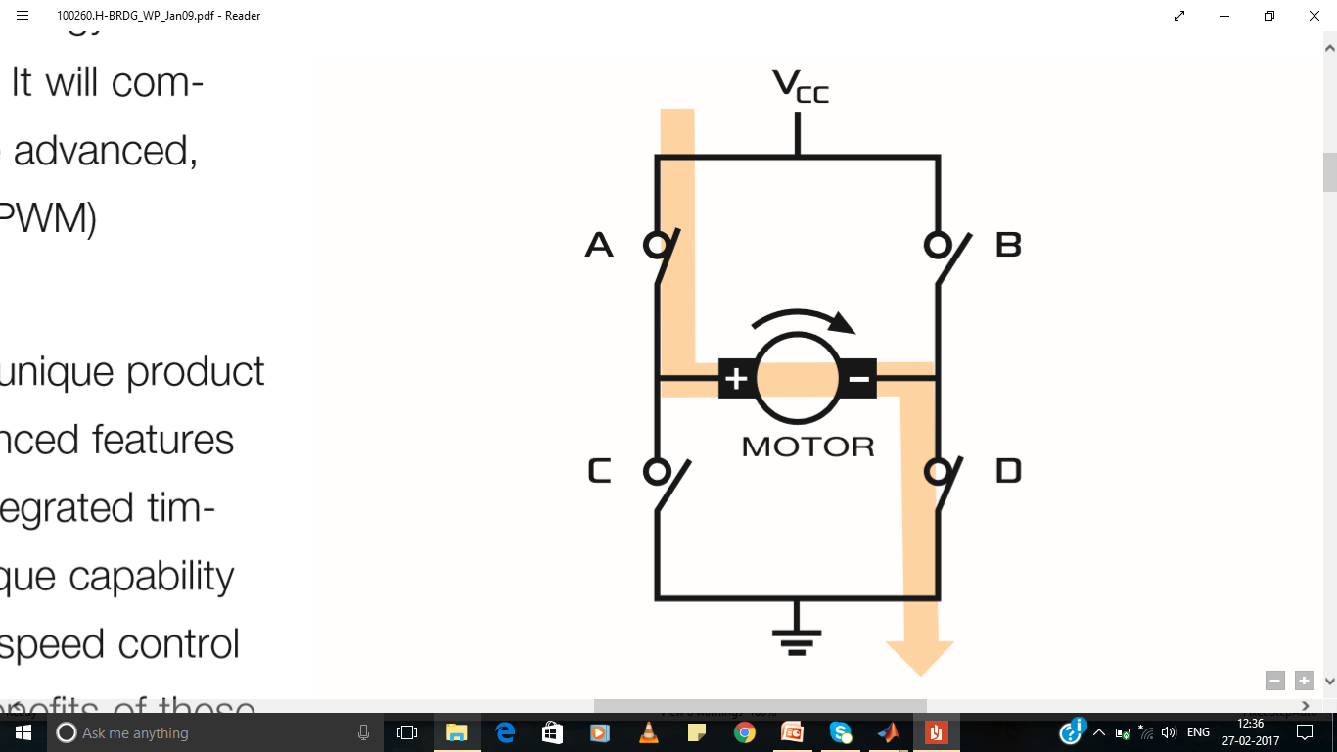
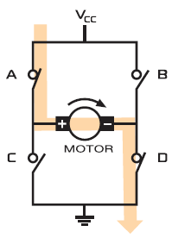
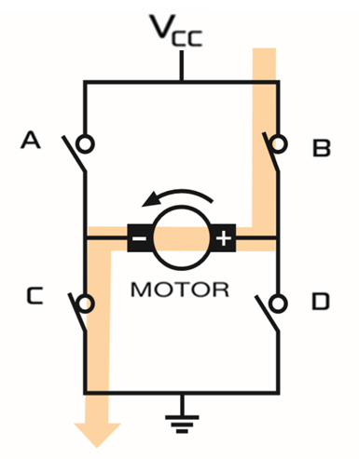
Operation of H-bridge

Slide 17
Open Loop Control System
Duty ratio is controlled by using PWM signal from Arduino
Directly Duty ratio can be given to PWM block
Here relation between speed and duty ratio are considered.

Slide 18
Block Diagram
An Open loop Control system for speed control of Permanent Magnet DC motor.
Dc Supply
rx
tx
Motor Driver
PMDC
Pc with simulink
Arduino
Encoder

Slide 19
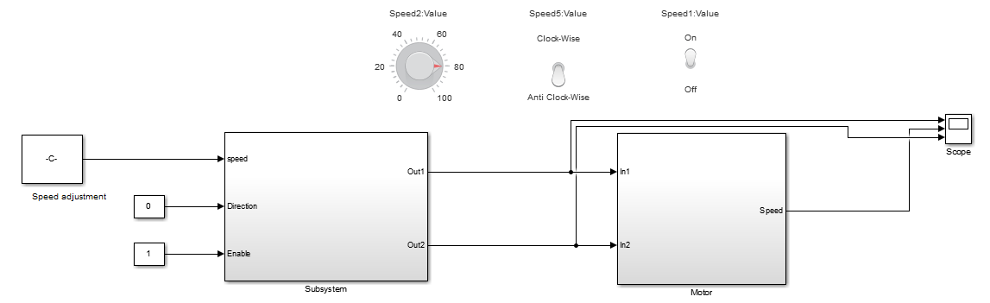
Simulink Model

Slide 20
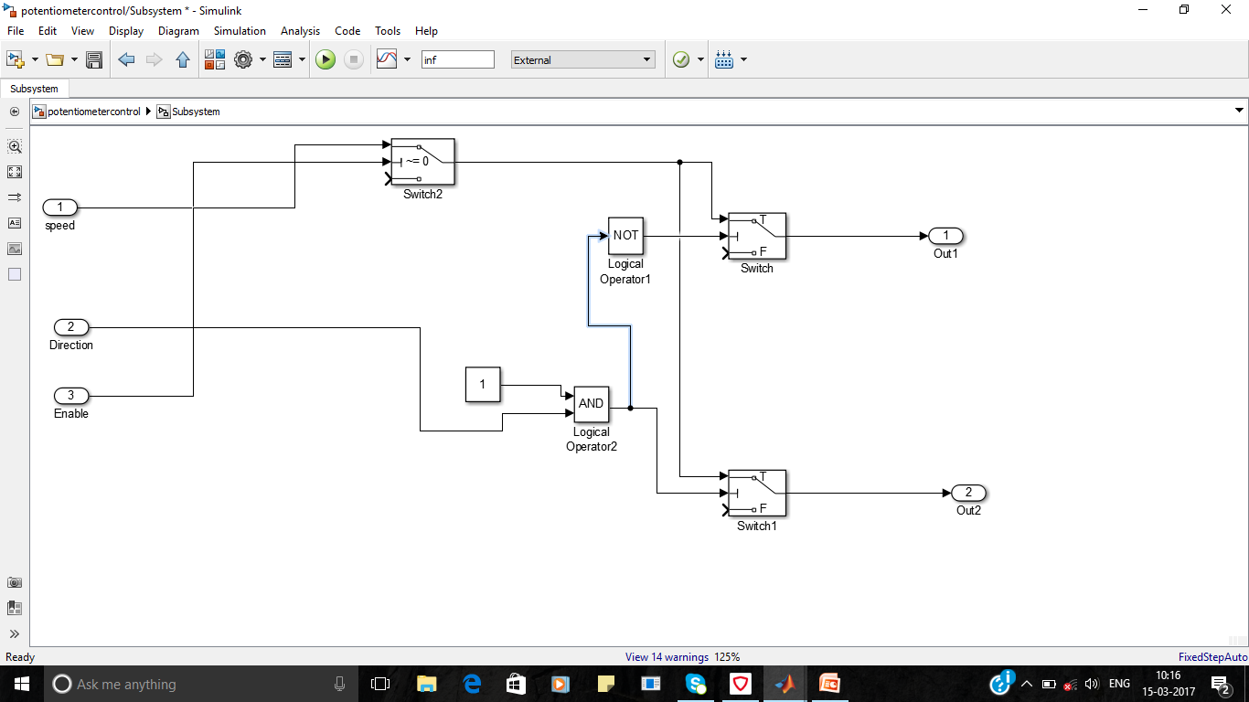
Sub System

Slide 21
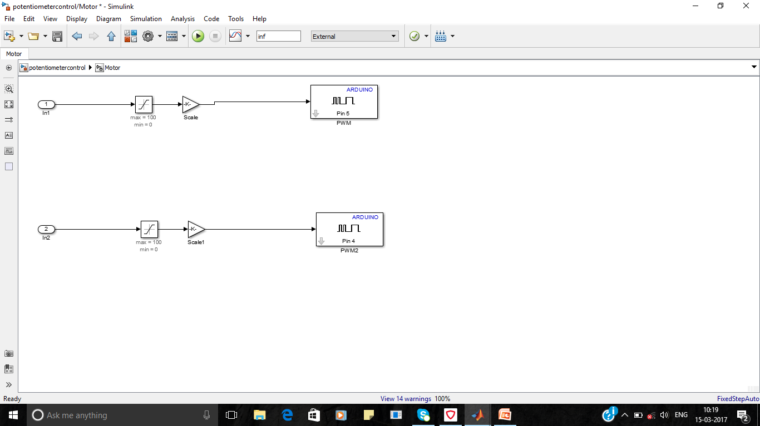
PWM O/P to the Driver

Slide 22
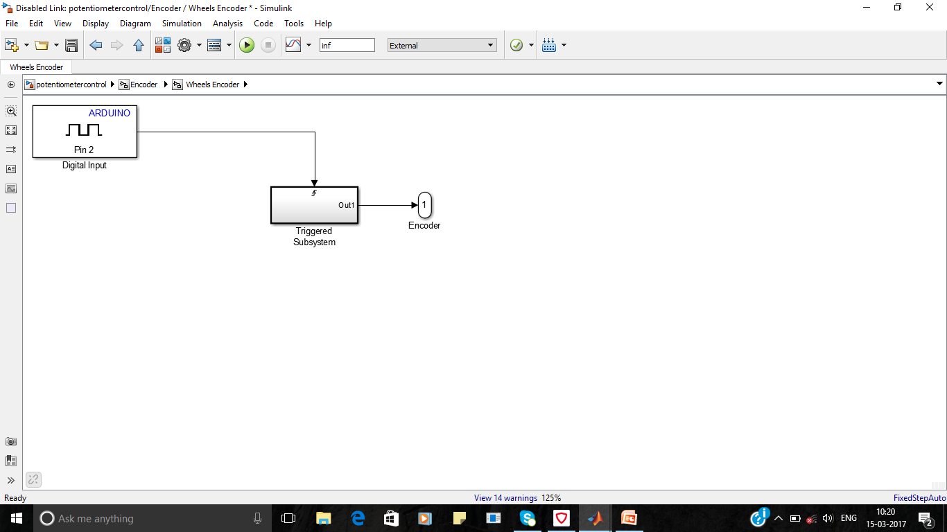
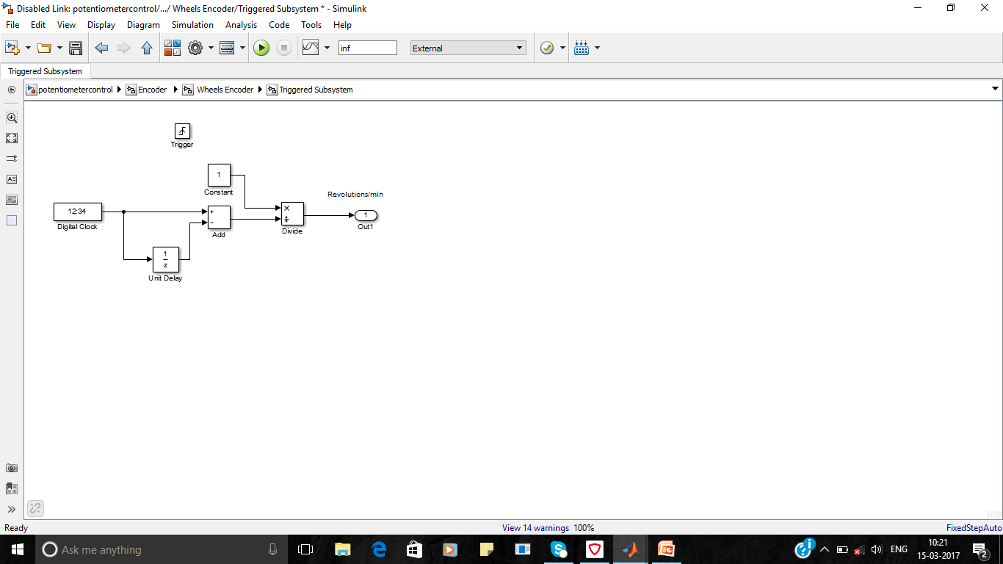
Encoder block
60
Speed =
RPM
T*N

Slide 23
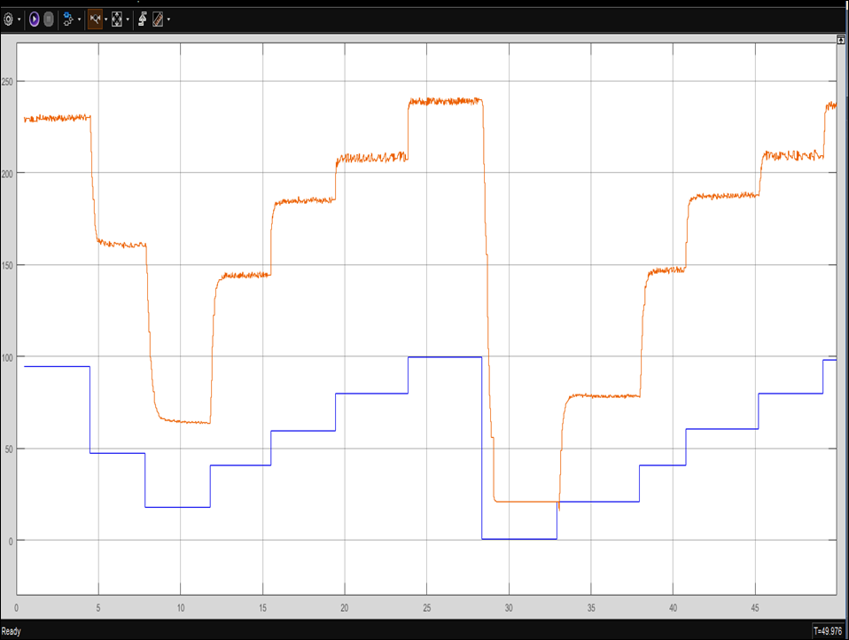
Results
Duty Ratio
Actual Speed

Slide 24
Closed loop system:
The Closed loop speed control of Permanent Magnet DC motor using P, PI and PID Control Techniques to maintain set Speed.

Slide 25
Closed loop speed control of Permanent Magnet DC motor
Dc Supply
rx
tx
Motor Driver
PMDC
Pc with simulink
Arduino
Encoder

Slide 26
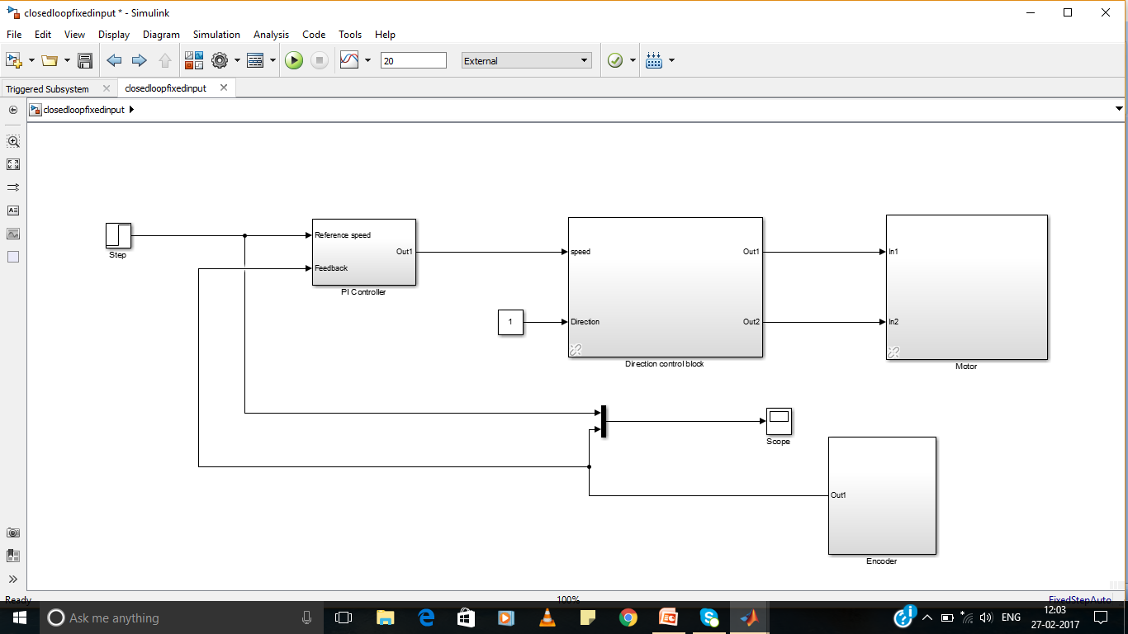
Simulink Model

Slide 27
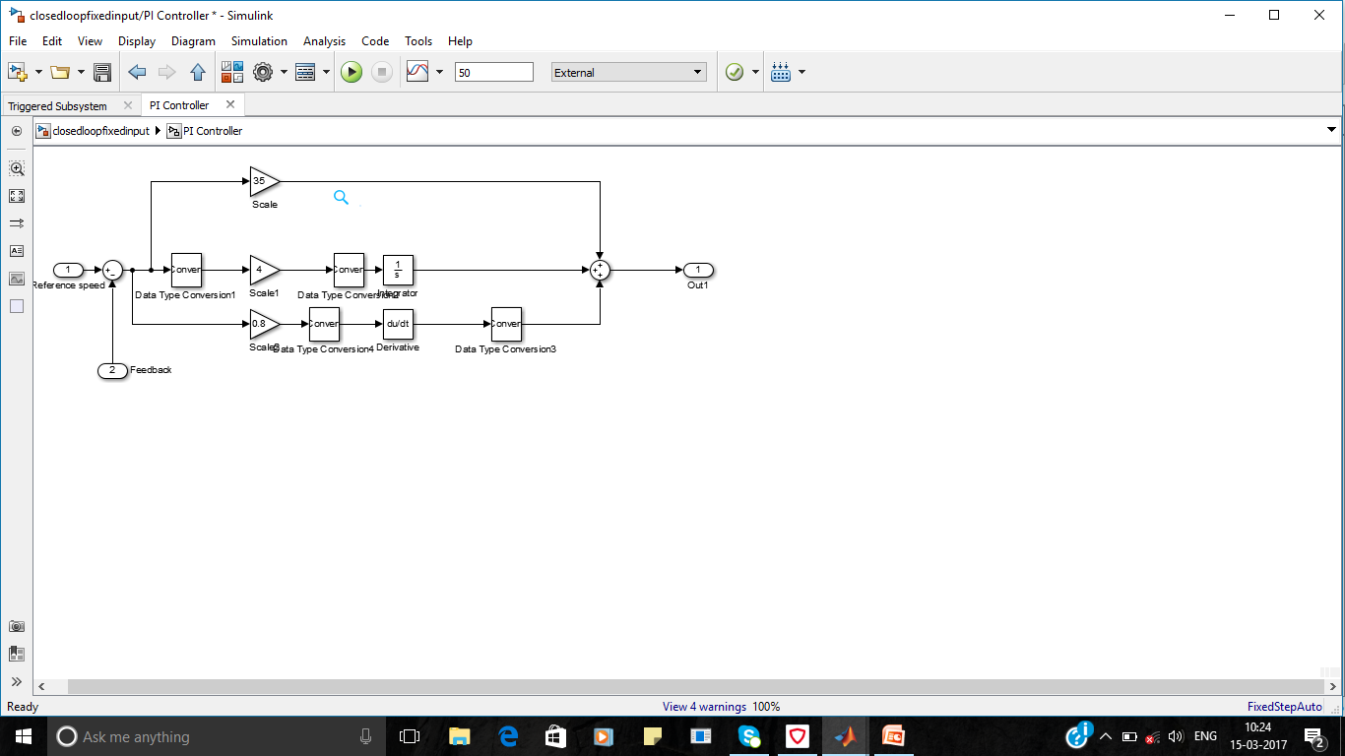
PID Block

Slide 28
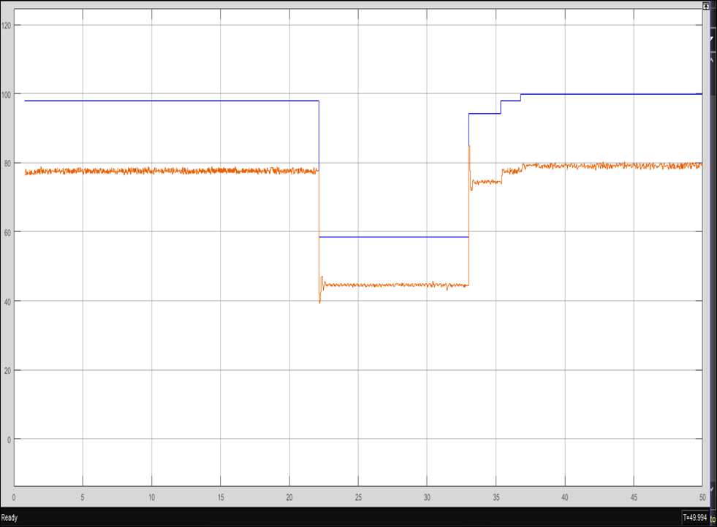
Closed loop with P controller
Set Speed
Actual Speed

Slide 29
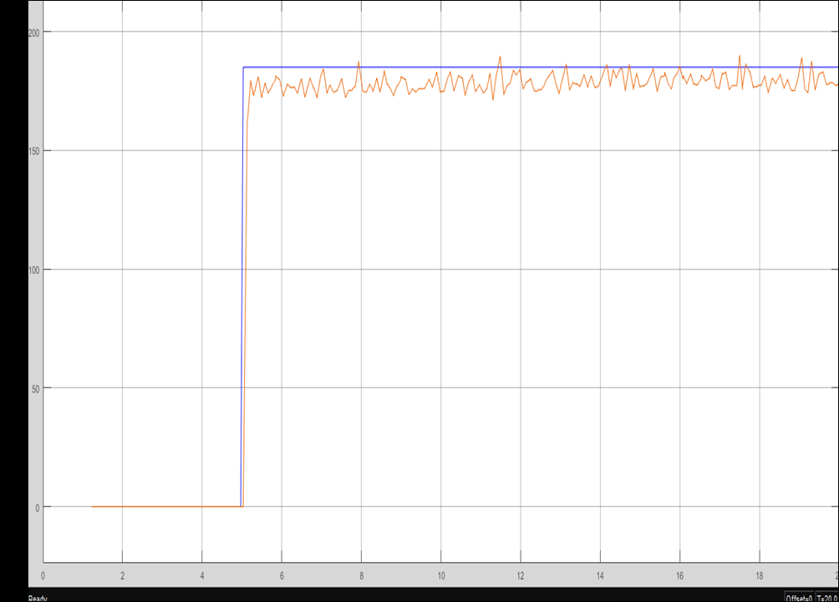
Set Speed
Actual Speed
Closed loop with
PI controller for fixed Input

Slide 30
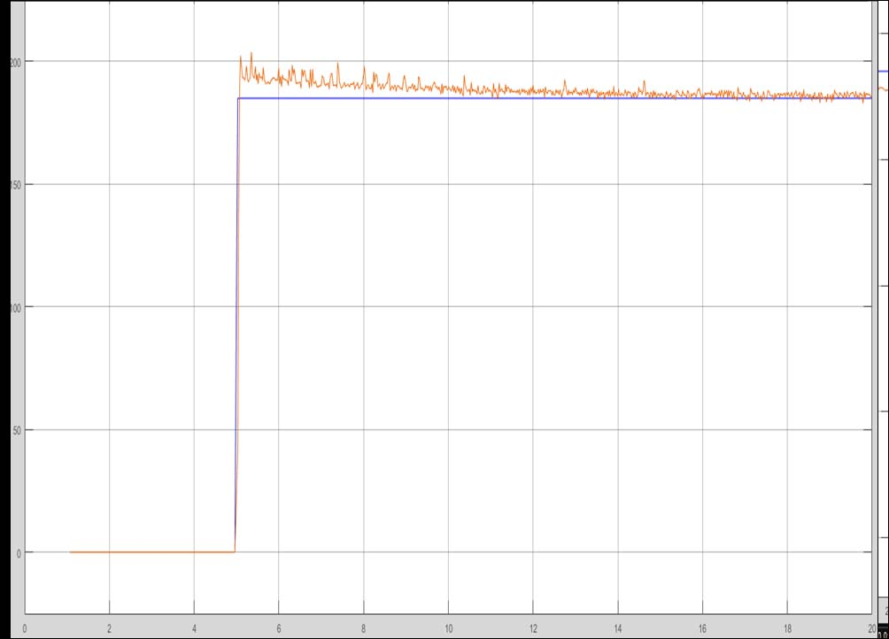
Set Speed
Actual Speed
Closed loop with
PI controller for fixed Input

Slide 31
Application
Robot motion control
Educational Kits

Slide 32
Future Scope
Fuzzy logics can also be implemented
Communication Devices can added.

Slide 33
Conclusion
Controllers can be designed in Micro Controllers in a easy way
Different types of Converters can be implemented and results can be analysed in MATLAB.

Slide 34
Thank You..

